Slide 1

salesforce Guide
Mango CRM Platform

Slide 2
Agenda
Welcome to Salesforce
Who Uses Salesforce Understanding Omnichannel & Case Load System
Case Actions – When to Use Resolve or Close
Escalation vs Request Split Feature
Customer History Panel
Pro Tips for Smart Salesforce Work
|

Slide 3
Welcome to Salesforce
Salesforce is the main tool used across all Mango Contact Centers to manage customer interactions.
It helps agents handle:Emails
• Chats
• Phone calls
• Social media messages
💡 Why it’s important:
It tracks all customer history, assigns tasks smartly, and makes sure no message is missed. It keeps everything in one place—clean, fast, and easy.

Slide 4
Who Uses Salesforce – Roles & Responsibilities
👤 Agents: Handle cases, respond to customers, send escalations or requests.
👩‍💼 Team Leaders: Oversee performance, assist in complex or escalated cases.
🏢 Internal Teams: Like Billing or Online Ops—receive escalations when agent support isn’t enough.
🔄 Omnichannel: The tool that distributes cases automatically.It decides who gets what based on agent availability, skills, and case priority.

Slide 5
Understanding Omnichannel & Case Load System
Text:
⚙️ Omnichannel Status = Case Flow Control
• Available → Active for Email + Chat
• Available Phone → Only Phone
• Busy / Away → No cases assigned
📊 Case Load Points:
• 1 Email = 6 points
• 1 Chat = 2 points
• Phone = 1 at a time
Limit: 8 points
💬You might get:
• 1 email + 1 chat
• 3 chats + 1 phone
• Or just 4 chats
⚠️ Don’t forget to set the correct status when returning from breaks!

Slide 6
Case Actions – When to Use Resolve or Close
🟢 RESOLVE = You already replied
Use when:
When we provide information about an inquiry
We inform them that their inquiry is pending with another department
We respond that we cannot help or do not have the requested information (such as certain measurements, for example)
🔴 CLOSE = No reply needed
Use when:
Customer says “Thanks”, issue solved
It’s a duplicated case
The protocol says to close it directly
💡 Tip: If you close a case, don’t forget the Close Reason!

Slide 7

Escalation vs Request – What’s the Difference?
📨 Request = Sent outside Mango
• Example: Ask a store to hold an item
• Needs classification + external contact info
🔺 Escalation = Sent internally to Mango teams
• Example: Billing error → goes to Billing team
• Add all needed info & internal notes
💡 Always check if a request/escalation already exists (check the History Panel) before creating a new one.

Slide 8
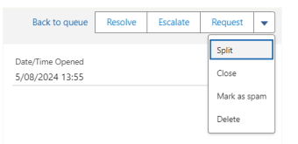
Split Feature
🧩 Split Feature
• When the customer asks about 2+ topics in one message
• You can split the case into 2 cases
• Only the original case can be split

Slide 9
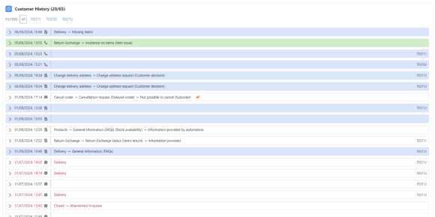
Customer History Panel
🕵️‍♀️ Customer History Panel
Found at the bottom of the case
Shows previous contacts
color-coded:
Blue = Open
White = Resolved
Red = Closed
Green = Active case
💡 Use this panel before answering or closing a case.

Slide 10

Pro Tips for Smart Salesforce Work
✅ Check Omnichannel status regularly
✅ Don’t reply if not needed—use Close properly
✅ Always check Customer History
✅ Escalate/request only when necessary
✅ Rephrase when closing related cases
✅ Don’t contact teams out of your scope
💬 Example: Don’t contact stores directly if it’s not in protocol. Always follow the flow.

Slide 11

Let´s be brilliant together!
Quality and Training Team Mango and Transcom
|

